Slide 1

Opportunity Zones 2.0
Catherine Lyons,
Senior Director of Policy & Coalitions
June 2026

Slide 2
Why do Opportunity Zones matter?

Slide 3
Why do OZs matter?
Because they’re bringing capital to communities
More than $100 billion in direct equity capital has been invested in OZs.
Approximately three-fourths of all designated tracts have seen investment.
The rate of housing unit growth in OZs has more than doubled since designation.

Slide 4
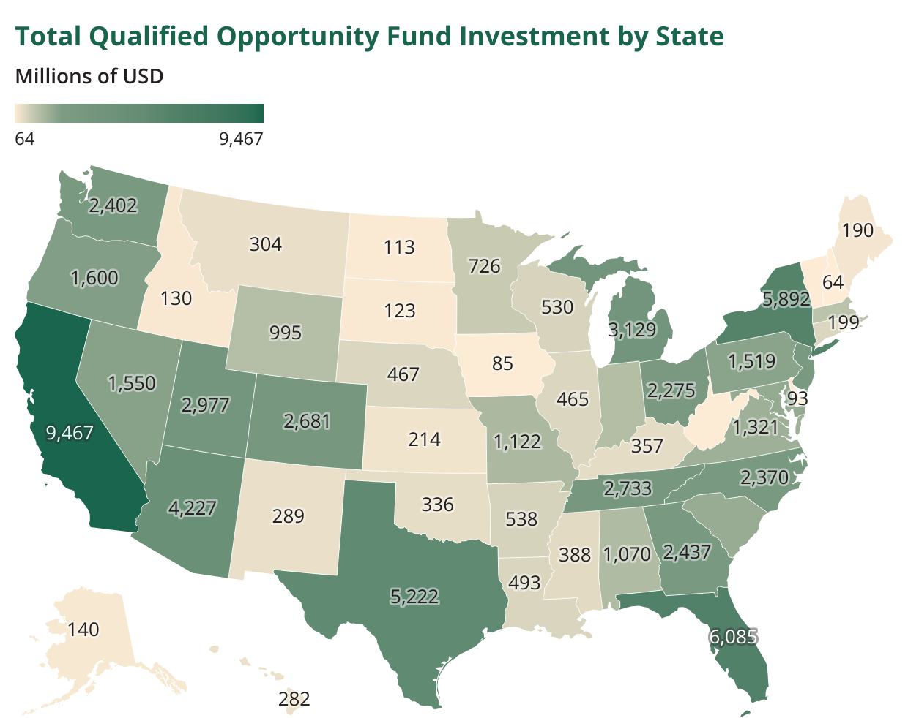
Nationwide, >$100 billion has been invested in OZs to date.
Through 2022, 46 states had received more than $100 million in OZ capital.
24 states had received more than $1 billion.
Source: Joint Committee on Taxation, May 2024 | Data through 2022

Slide 5
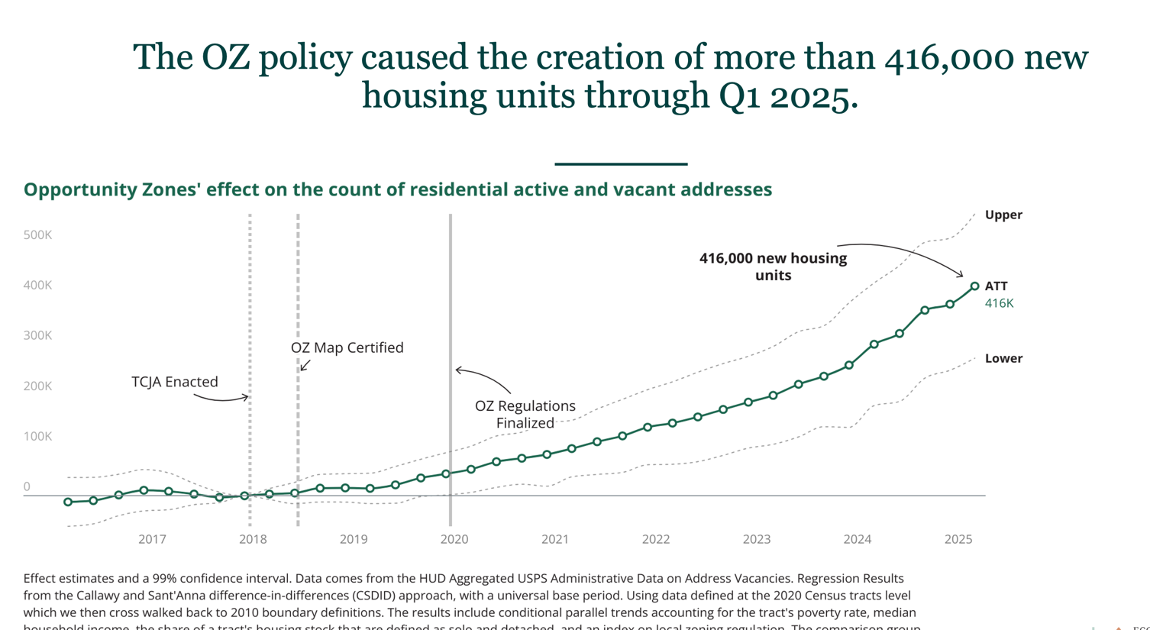

Slide 6
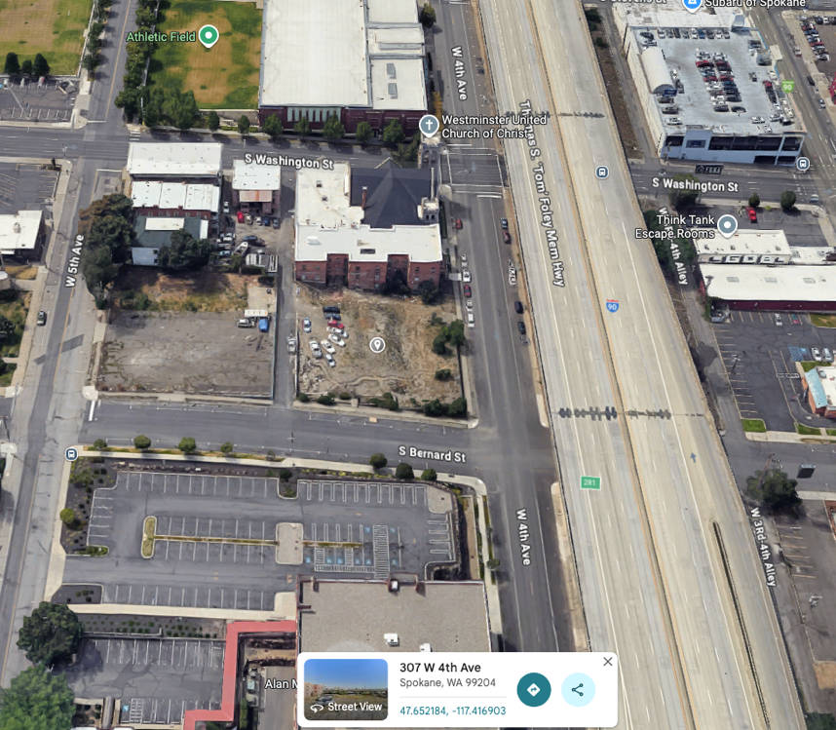
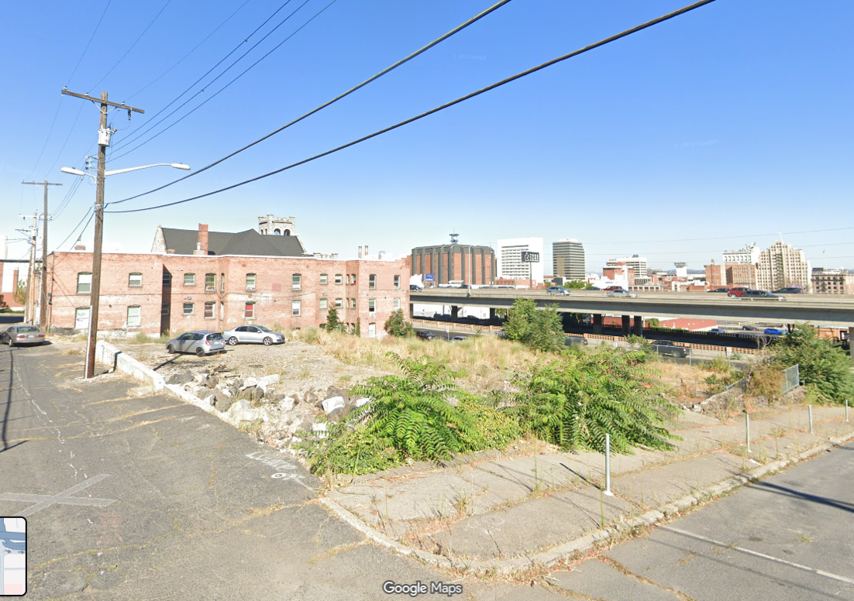
OZs in Action
OZ investments frequently take the form of multifamily residential in-fill development
Before
Notes:
New JCT analysis with data through the end of 2022

Slide 7
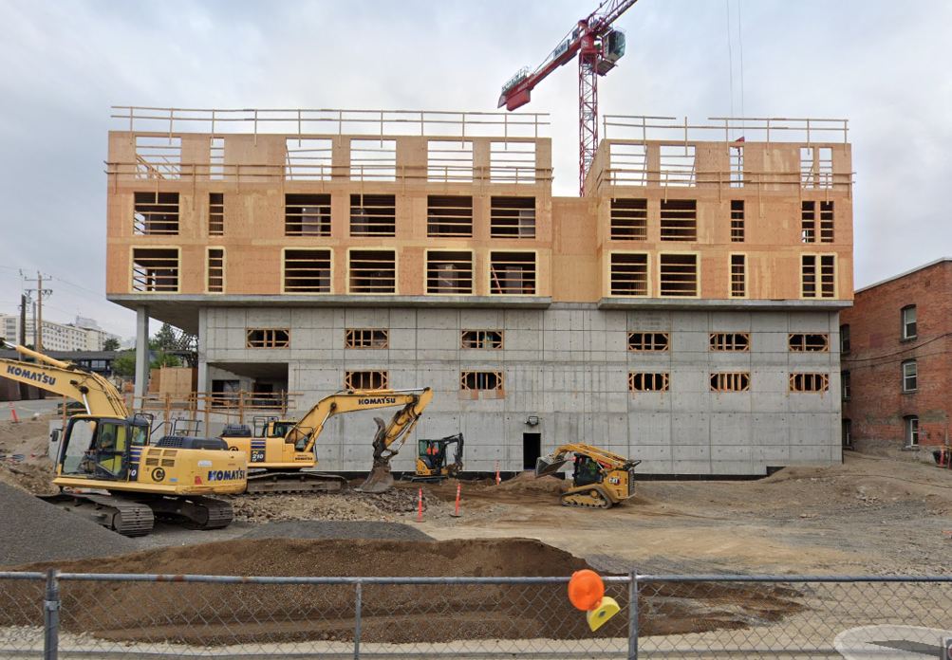
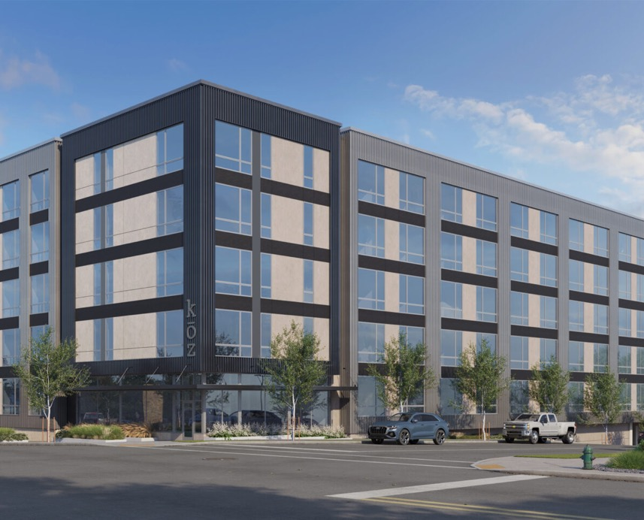
OZs in Action
OZ investments frequently take the form of multifamily residential in-fill development
After
Notes:
New JCT analysis with data through the end of 2022

Slide 8
How OZs work

Slide 9
Who are OZ investors?
OZs offer capital gains tax incentives, meaning any private entity with a capital gains tax liability is a potential OZ investor.
Individuals
Corporations
Institutional investors
Private equity
Banks
Landowners

Slide 10
Where are OZs?
Opportunity Zones are low-income census tracts (LICs) designated by governors.
Governors nominate 25% of their eligible LICs to be OZs, where investors are entitled to certain tax benefits.
Governors are preparing to nominate the next round of tracts with OZ designations that will last a decade.
Getting zone nominations right is fundamental to long-term success.

Slide 11
What are the OZ tax benefits?
OZ investors are eligible for a series of capital gains tax incentives.
A 5-year deferral of taxes owed on a capital gain rolled over into a dedicated Opportunity Fund (OZ investment vehicle).
A 10% step-up in basis on that tax bill once it comes due.
        30% in rural areas.
A permanent exclusion (i.e., no capital gains taxes) on any subsequent qualifying (i.e., economically additive) investment made in OZs and held for at least 10 years.

Slide 12
How do OZs work?
OZ designations do not guarantee investment.
OZs reward investing in low-income communities by increasing the potential returns on successful investments.
OZs deliver equity capital to projects.
The OZ incentives can be used to build new structures and rehabilitate old ones. They can also be used to invest in businesses, business property, and capital equipment.

Slide 13
What worked in OZs 1.0
Worked!
Sometimes worked…
Did not work.
New and refurbished multifamily rental housing
Workforce housing
Mixed-use developments
Adaptive reuse and historical rehabilitations
Real estate for commercial purposes
Urban, semi-urban, and suburban in-fill development
Deeply affordable housing
Pairing with LIHTC and NMTC
Business investment
Diversified rural investments*
CDFI/impact sector engagement*
Single-family homes (especially for sale)
Venture-style equity investment
Direct investment into small businesses
“Retail” investor participation
Widespread rural investment*
Transparency*
*expect to change or improve with 2.0

Slide 14
Remember, the OZ incentive is flexible in:
Who can use it (anyone with a capital gain)
How much they invest (low overhead means large or small)
What it goes towards (as long as it’s new or improved, economically additive and in a zone, it’s likely qualifying).
Wherever there’s a place for equity investment, there’s an opening for OZ capital.

Slide 15
What’s new in 2.0

Slide 16
OZ 2.0: What’s new
Incentive structure. Changes will result in a smoother, more predictable flow of investment.
Rural provisions. Significant added tax benefits for rural investments will influence behavior.
Reporting and transparency. A robust data collection and publication regime will demystify OZ investment.
Zone eligibility and designation. Stricter targeting criteria will produce a narrower map.

Slide 17
Zone Eligibility and Designation
Decennial zone selections
New investment maps will be set every 10 years starting January 1, 2027
The 1.0 map will still be in effect for the first two years of the 2.0 map (until December 31, 2028)
      Key date: the 90-day window for new zone designations will kick off July 1, 2026.
Eligibility criteria
Poverty rate remains at 20%
    However, tracts qualifying on poverty must have a median family income below 125% of the area benchmark.
Median family income falls from 80% of the area benchmark to 70%.
This reduces the number of eligible tracts and future OZs by >20%.
As before, governors nominate 25% of their qualifying tracts as OZs, with a 25 tract minimum.

Slide 18
Zone designations deep dive

Slide 19
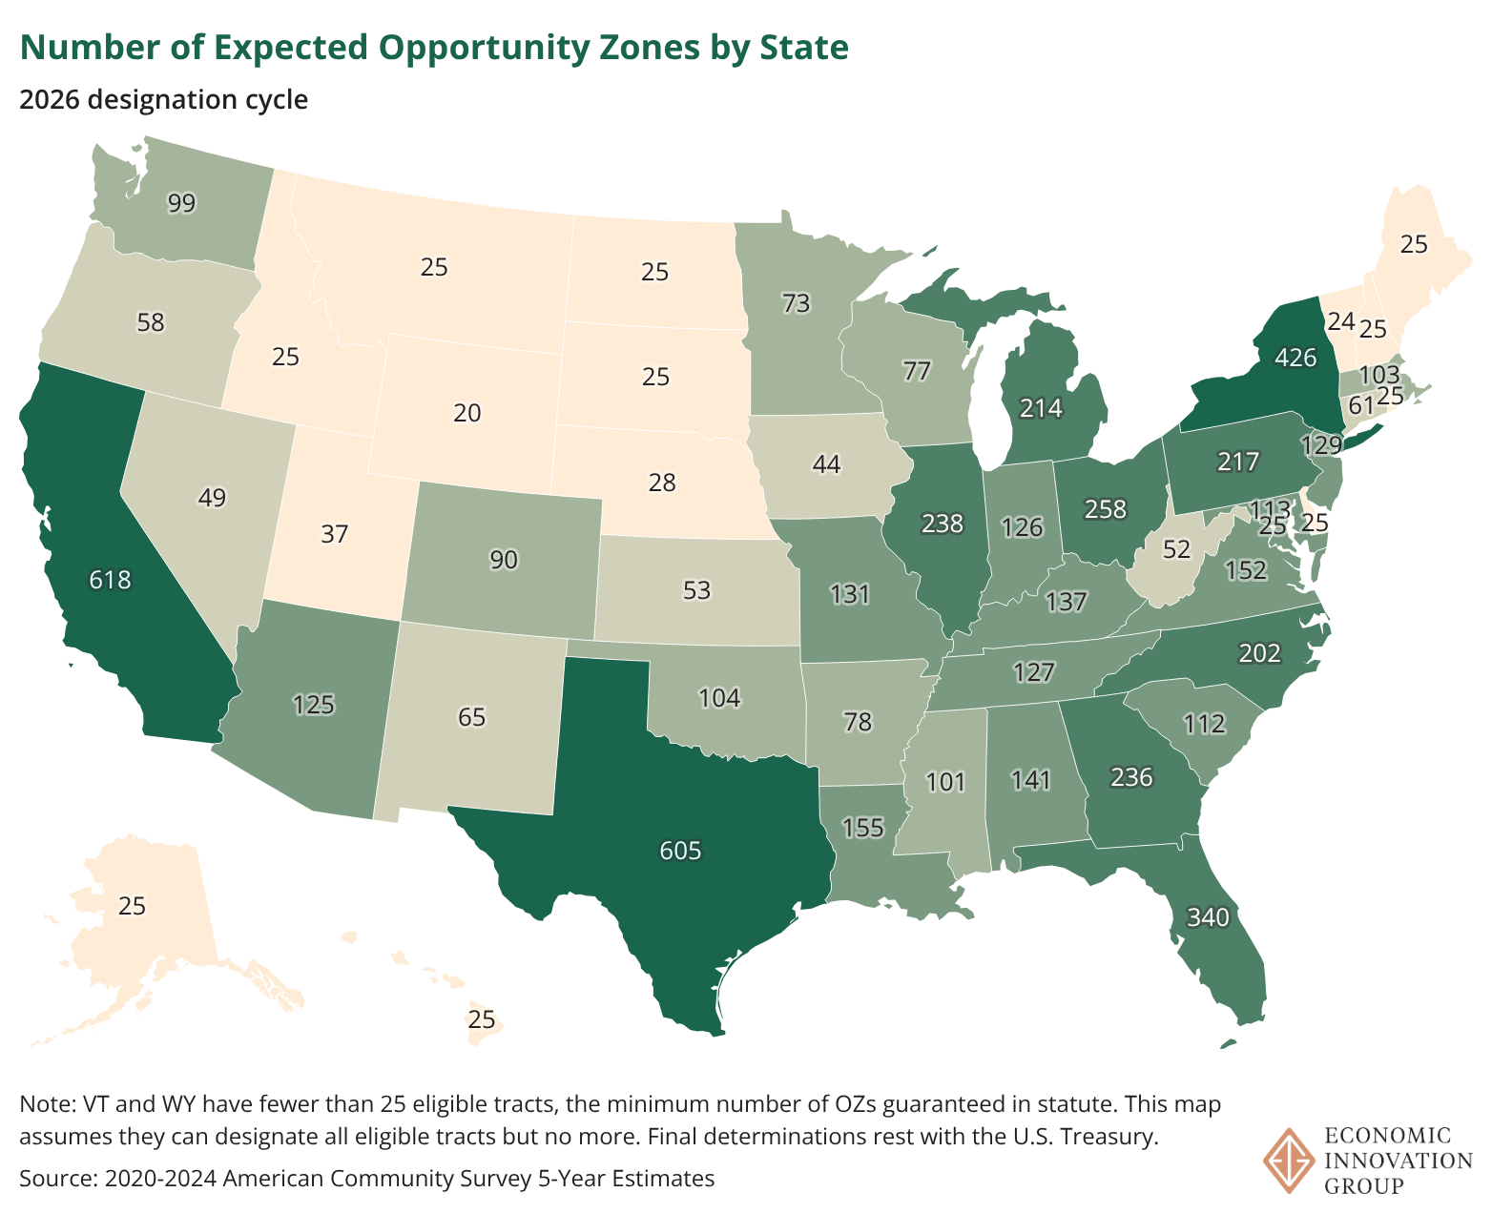
Stricter eligibility criteria mean that most states will have ~20% fewer OZ tracts to nominate in 2026.
Nationally, the number of OZs is expected to fall from 8,726 to 6,304.

Slide 20
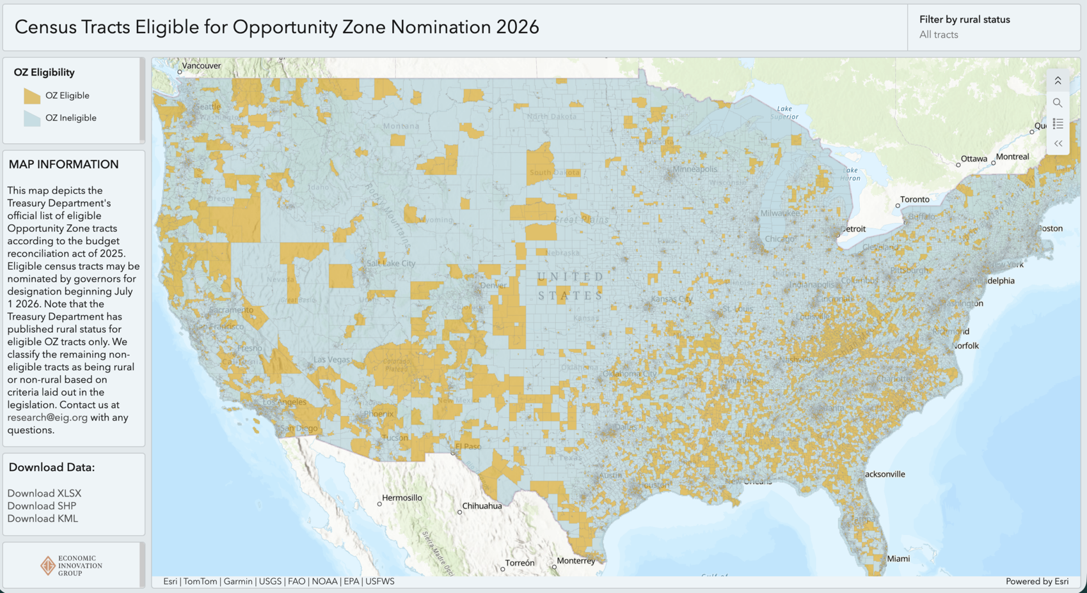
EIG has mapped eligible census tracts on our website
https://eig.org/ozs-resources/

Slide 21
Why should communities care about OZs?
OZs can help close deals and get good projects off the ground.
OZs can drive in-fill development; complete the neighborhood fabric.
OZs can help mobilize local reinvestment or “local-vesting” efforts.
OZs can directly help address housing shortages at all price levels.
The boosted rural incentives should spark economic development.
OZ designation can put more power—and private capital—behind your plans.

Slide 22
A three-part test for identifying good OZ tracts
The community test:
Does the area genuinely need new investment to grow and diversify their economies so that residents can prosper?
The market test:
Does the area have a reasonable chance to attract private capital and put it to productive use within the policy’s timelines?
The policy test:
Are local policies investment-friendly and conducive to economic development?

Slide 23
Key questions for local leaders
Where do you wish to channel development?
Where have you recently invested in infrastructure or enacted zoning reform?
What are your priority neighborhoods for economic revitalization?
What are your core anchor assets in eligible census tracts?
Which tracts might be primed for housing and which for commercial development?
Where are your brownfield sites? Where is there the greatest potential for in-fill?
Are there nascent poles of population growth on which you’d like to build?
Are there opportunities for workforce housing along key transit corridors?
Where does the county have land that could be contributed to high-impact projects?

Slide 24

What tools are at your disposal to influence outcomes?
To contribute to projects:
Permitting and approvals!
Publicly-owned land
Ground leases
Occupancy guarantees
To drive investment towards impact:
Main Street and small business grant programs
Parcel assembly and remediation
Capacity building and ecosystem development grants

Slide 25
OZs in action — and impact

Slide 26
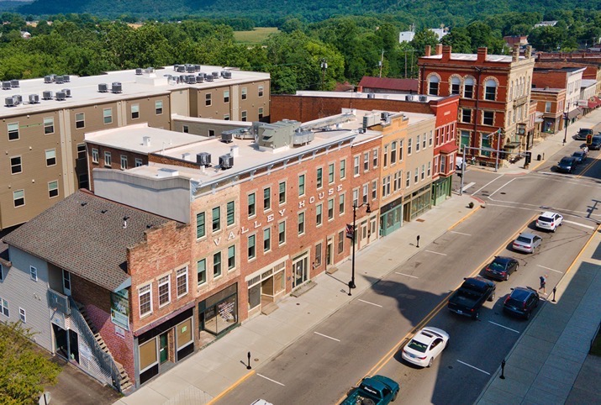
Case Study: Brookville, IN
Brookville had not seen any new development in more than 20 years when leaders approached a local developer with a plan to redevelop the historic downtown.
Brookville’s size, lack of recent development, and the mixed-income, mixed-use nature of the project made it difficult to finance.
The original plan was scaled back and delayed until Brookville was designated as an OZ.
An OZ investment by a local couple allowed the concept to move forward.
The Valley Flats project offers 27 apartments with assisted living services for seniors, 20 market-rate units, a pharmacy, restaurant, and a movie theater.
The investors also used OZ financing to acquire a local newspaper, allowing it to modernize and continue to serve the community, and bring the first hotel to the area.

Slide 27
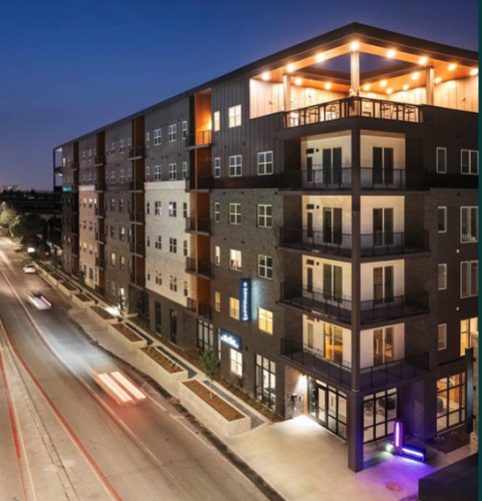
Impact Case Study: The Stella in Indianapolis
Creates 166 affordable and workforce apartments. The units are restricted to renters earning between 30 and 120% of AMI.
Provides more than 1,600 square feet of ground floor retail space located along the IndyGo Red Line.
Transforms a long-blighted site and replaces three vacant industrial office buildings.
City supported the project through a TIF.

Slide 28
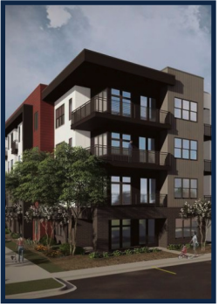
Impact Case Study: The Westmont Workforce Housing in Indianapolis
Transforms a former brownfield site in a community with a poverty rate of more than 40 percent.
Creates 188 new affordable and workforce apartments, 170 of which will be affordable to people living at or below Area Median Income.
The City of Indianapolis requires these rent restrictions through a 10-year tax abatement agreement, ensuring the neighborhood’s current residents will have access to affordable housing.
Creates five new permanent, living-wage jobs.
The project benefitted from the Industrial Recovery Tax Credit program issued by the Indiana Economic Development Corporation.

Slide 29
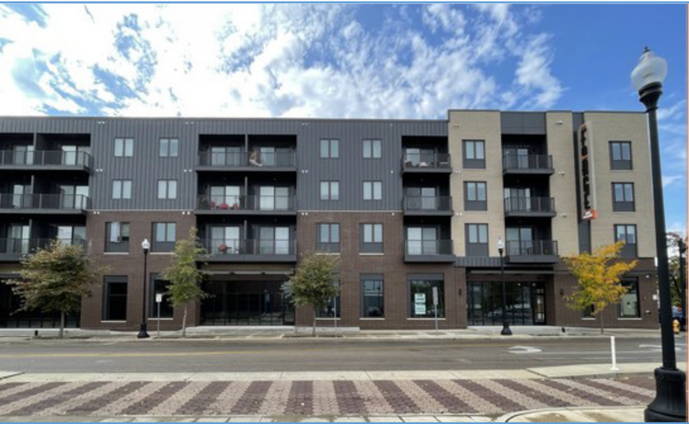
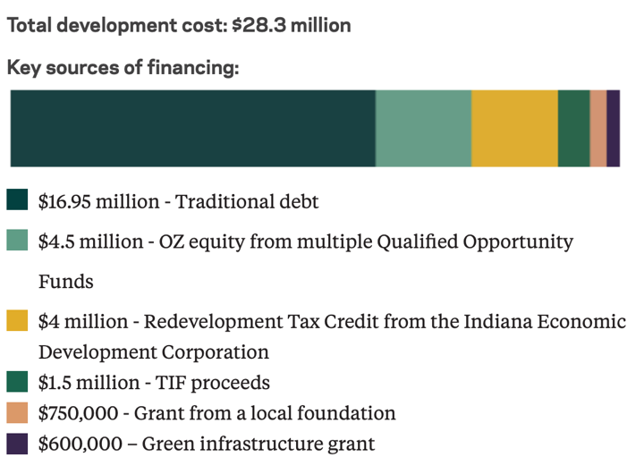
Impact Case Study: Forge on Main
Neighborhood revitalization and workforce housing in Evansville, IN
Project creates 180 new residents and commercial space.
Local OZ investors connected with national impact investors through the statewide OZ consortium managed by LISC.
Much-needed new quality housing near downtown.
Remediated a superfund site and alleviated a food desert.
OZ funding raised from six investors combined with state tax credits and city TIFs.

Slide 30




EIG brings together leading entrepreneurs, investors, economists, and policymakers from across the political spectrum to address America’s economic challenges.
Catherine Lyons
catherine@eig.org
EIG.org
facebook.com/EconomicInnovationGroup
linkedin.com/company.economic-innovation-group
twitter.com/InnovateEconomy

